Slide 1
Integration and Collaboration
Integration & Collaboration

Slide 2
How The Relationship Began…
MOU
Board Meetings
Monthly Center Meetings
Joint Work Sessions
Open Communication
Commitment and understanding:
Integrated, not separate
Notes:
Pam

Slide 3
AEL & Workforce “Teamwork”
Workforce assists with recruitment and outreach
Workforce Solutions provides class space at all sites
AEL provides TABE testing for each Workforce Solutions Center
AEL students attend Workforce Center job/ hiring fairs
Notes:
Brenda

Slide 4
Ways That We Work Together
Cross-refer students/clients
Child Development Pathways Collaboration
Innovative Partnership Grant
Paid Work Experience
AEL staff has TWIST access
Notes:
Danielle

Slide 5
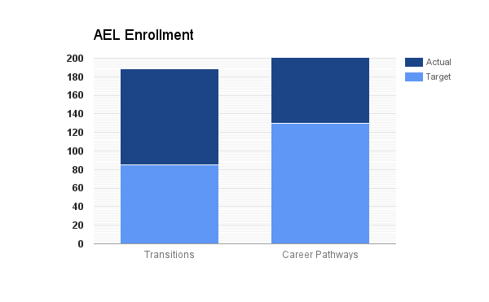
AEL Outcomes
Transitions enrollment exceeded by 23%
Career Pathways enrollment exceeded by 35%
Actual: 176
Actual: 104
Target: 130
Target: 85
Notes:
Danielle

Slide 6
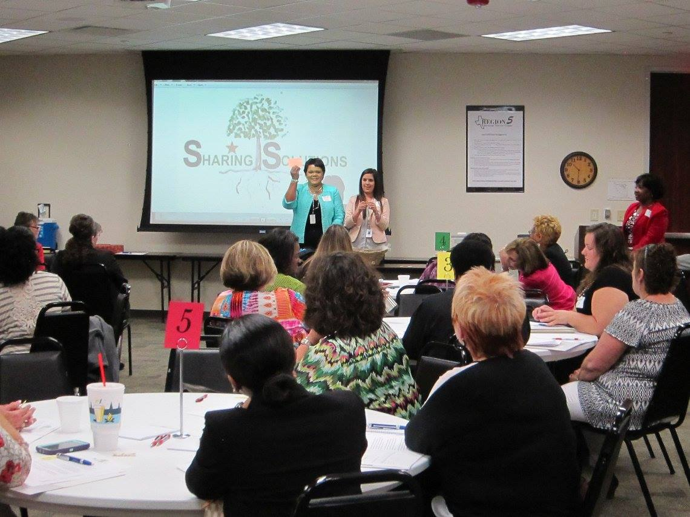
Workforce Outcomes: SUCCESS
INTEGRATION = Increase in Awareness for AEL and Workforce
Partnership and Collaboration
Sharing Solutions, a professional social services group
Child care Quality Conference
AEL Performance Quality Improvement submission
Actual: 176
Actual: 104
Notes:
Pam

Slide 7
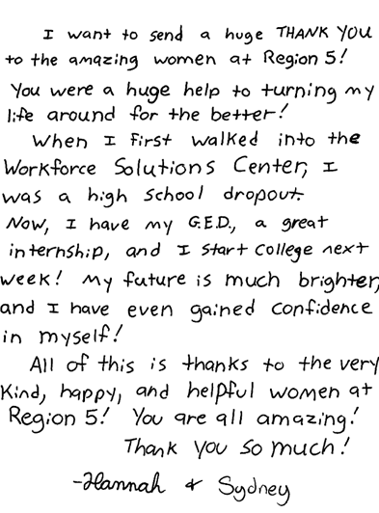
Note and Thank you
Notes:
Danielle

Slide 8
Contact Information
Pam Wise Workforce Solutions of Southeast Texas
pamela.wise@setworks.org
Brenda Schofield Region 5 ESC
bschofield@esc5.net
Danielle Grundy Region 5 ESC
dgrundy@esc5.net

